Slide 1


CA Task Delegation & Tracking App
From a single-line request to a database-backed internal tool for Chartered Accountant firms — built end-to-end with Claude Cowork.

Slide 2







The Operational Problem
Scattered Tasks
Zero Visibility
Generic Software Fit
Adoption Barriers
Task assignments were fragmented across phone calls, WhatsApp chats, and loose paper notes without a central source of truth.
Partners couldn't easily see who owned what task, what was overdue, or who was overloaded until client calls came in.
Off-the-shelf project tools lacked CA workflow tags like GST Filing, Income Tax Returns (ITR), and Audit tracking.
Staff required an intuitive solution with zero passwords to remember, no steep learning curve, and zero complex IT setup.

Slide 3
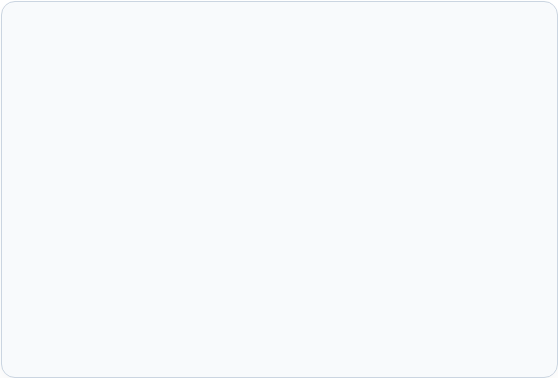
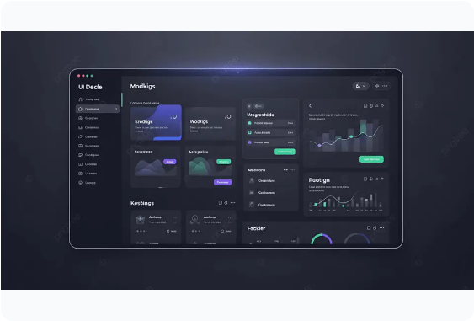
The Architectural Solution
Real Database Backend
SQLite engine tracking clients, task types, priorities, due dates, and live status reliably.
Role-Based Multi-User Accounts
Admin provisions team access; members manage personal tasks while partners retain firm oversight.
Shared Multi-Assignee Tasks
Collaborative task allocation with complete assignment dates and days-pending trails.
Live Color-Coded Dashboard
Interactive status, priority, and workload charts generated in real-time using Chart.js.

Slide 4












End-to-End Build Pipeline
1. Clarify
3. Frontend
5. Package
Framed exact CA firm needs
Clean dashboard & task UI
Launcher & desktop app
2. Backend
4. Test
6. Iterate
Node.js server & SQLite DB
API & browser verification
Feedback & feature fixes

Slide 5


Zero-Dependency Tech Stack
Backend & Database Layer
Frontend & Presentation
✓
Claude Cowork Engine: Full build orchestration inside a single AI conversation environment.
✓
Plain HTML / CSS / JS: Superfast load times, zero build steps, and easy maintenance.
✓
Node.js Runtime: Standard execution engine — eliminating complex external hosting tools.
✓
Chart.js Library (CDN): Dynamic visual analytics rendering real-time workload metrics.
✓
Native SQLite (node:sqlite): Relational database engine without requiring npm package installs.
✓
Optional Electron Shell: Converts web view into a native Windows desktop executable.

Slide 6
Evolution of the Application
Authentication Model
Task Allocation
UI & Aesthetics
Deployment Method
Started: "No login" single user. Evolved to: Secure username & password accounts for multi-user firm access.
Started: Single-assignee ownership. Evolved to: Multi-assignee support for joint assignment on complex audits.
Started: Standard HTML table elements. Evolved to: Friendly pill-style navigation tabs and color-coded status badges.
Started: Local terminal scripts. Evolved to: One-click Windows batch launcher and native desktop app packaging.

Slide 7

Core App Workflows
Intuitive Administration
The application interface allows quick modal-driven task creation specifying client names, task types (GST, Audit, ITR), deadlines, and multi-member team assignments.
Partners gain real-time visibility over pending days and priority escalation, while team members enjoy clear daily focus without clutter.

Slide 8
Personal Dashboard Upgrades
Team Member View
Partner / Admin Oversight
✓
Pre-filtered "My Tasks" view opens by default upon login to keep daily work focused.
✓
Complete aggregate view of all firm-wide tasks, deadlines, and client assignments.
✓
Personalized KPI cards showing individual pending, overdue, and urgent priority tasks.
✓
Workload breakdown by team member to quickly identify resource constraints.
✓
Simple toggle allows viewing shared firm tasks whenever joint collaboration is needed.
✓
Administrative capability to manage user accounts, roles, and master task statuses.

Slide 9





Engineering Challenges Solved
Port Retry Calculation
Electron DB Binding
Packager File Access
Setup Error Diagnostics
String concatenation converted fallback port 3000 to "30001". Fixed by forcing strict integer arithmetic in port retries.
Bundled Electron runtime lacked SQLite modules. Resolved by configuring Electron to invoke the computer's native Node.js engine.
Compressed packaging obscured background process files. Fixed by turning off disk compression on critical server assets.
Failed connections auto-closed setup windows. Re-architected error handlers to freeze logging windows for diagnostic review.

Slide 10
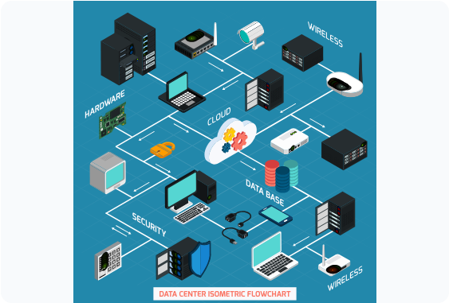
Network & OS Deployment
Windows SmartApp Control
SmartApp flagged script launchers; resolved via targeted file unblocking without disabling system security.
Email Zip Security Stripping
Gmail silently removed .bat scripts from zipped files; bypassed by deploying packages via Google Drive links.
Network Troubleshooting
Systematic diagnostics pinpointed firewall rules vs. changed internal IP addresses across office PCs.
Static IP Configuration
Configured static host IP routing to guarantee team access links remain stable after router reboots.

Slide 11
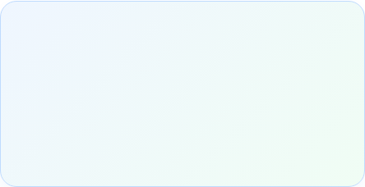

Results & Strategic Outcomes
Live Office Deployment
Currently handling daily task delegation & tracking across the firm's entire office network.
Zero Dependency Cost
No recurring SaaS subscriptions, no third-party API keys, and zero external hosting bills.
Production Operational
Dual Execution Support
Operates flexibly as a lightweight browser-launched web app or a native Windows desktop app.

Slide 12


What's Next for the App?
Future iterations include self-service password resets, optional HTTPS off-office remote access, and automated task deadline notifications.
Fully Editable Presentation
|
Production Code Ready

Slide 13



Image Sources
https://png.pngtree.com/thumb_back/fw800/background/20260416/pngtree-modern-dark-mode-admin-dashboard-user-interface-design-with-creative-data-image_21720633.webp
Source: pngtree.com
https://blog.potentiam.co.uk/hubfs/blog/images/redfin-accountant-desk-20260510-143304.webp
Source: blog.potentiam.co.uk
https://infraon.io/blog/wp-content/uploads/2025/10/4267665_17130.svg
Source: infraon.io

